Slide 1
Swift Day 09

Slide 2
Summary
Table View
Local DB

Slide 3

Table view
About Table Views in iOS Apps
Inside Table View

Slide 4
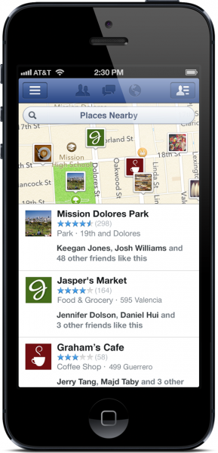
introduction
Table views are versatile user interface objects frequently found in iOS apps. A table view presents data in a scrollable list of multiple rows that may be divided into sections.
Table views have many purposes:
To let users navigate through hierarchically structured data
To present an indexed list of items
To display detail information and controls in visually distinct groupings
To present a selectable list of options

Slide 5
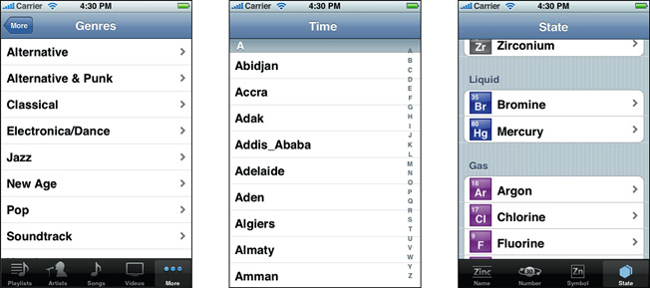

Slide 6
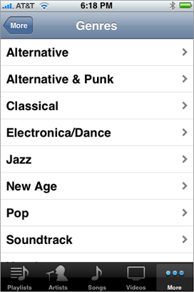
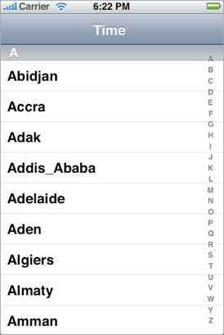
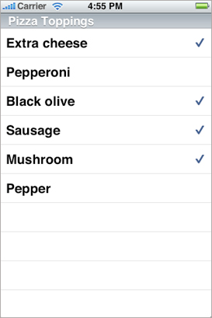
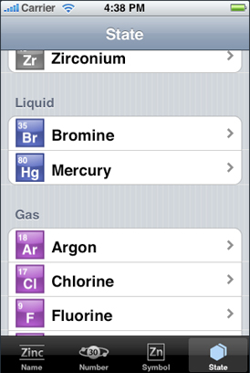
Table View Styles and Accessory Views

Slide 7
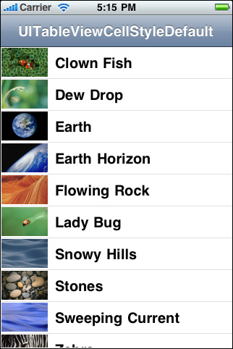
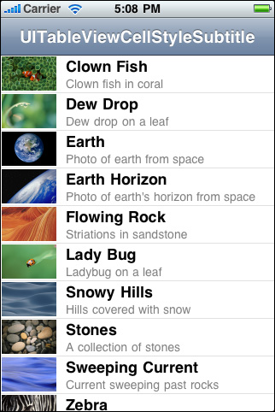
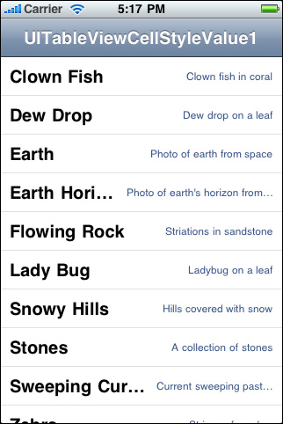
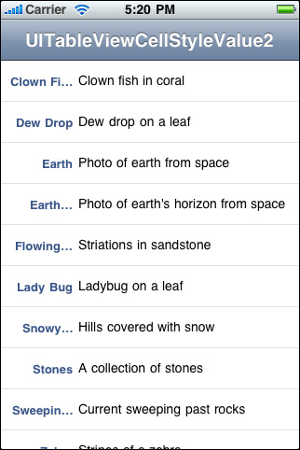
Standard Styles for Table View Cells

Slide 8
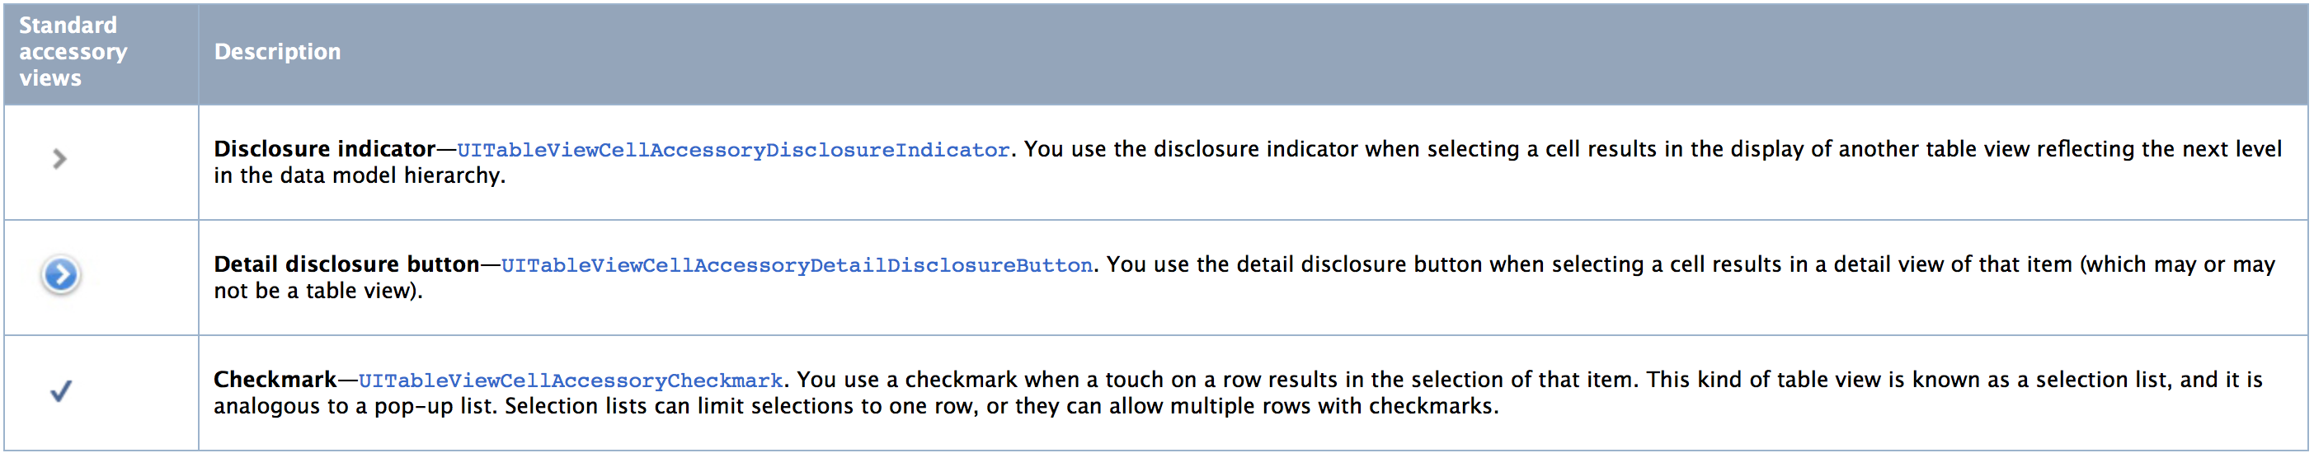
Accessory Views
There are three standard kinds of accessory views (shown with their accessory-type constants):

Slide 9
Overview of the Table View API
A table view itself is an instance of the UITableView class. You use its methods to configure the appearance of the table view—for example, specifying the default height of rows or providing a subview used as the header for the table. Other methods give you access to the currently selected row as well as specific rows or cells. You can call other methods of UITableView to manage selections, scroll the table view, and insert or delete rows and sections.
UITableView inherits from the UIScrollView class, which defines scrolling behavior for views with content larger than the size of the window. UITableView redefines the scrolling behavior to allow vertical scrolling only.

Slide 10
Table View Controller
The UITableViewController class manages a table view and adds support for many standard table-related behaviors such as selection management, row editing, table configuration, and others. This additional support is there to minimize the amount of code you have to write to create and initialize your table-based interface. You don’t use this class directly—instead you subclass UITableViewController to add custom behaviors

Slide 11
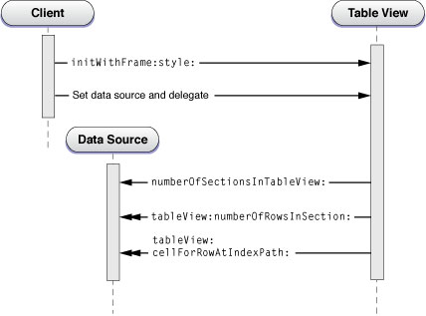
Data Source and Delegate
Creating and Configuring a Table View

Slide 12
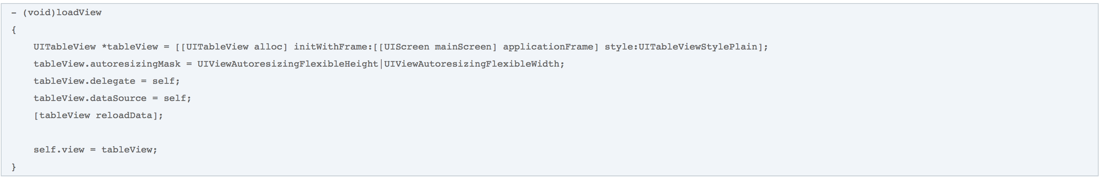
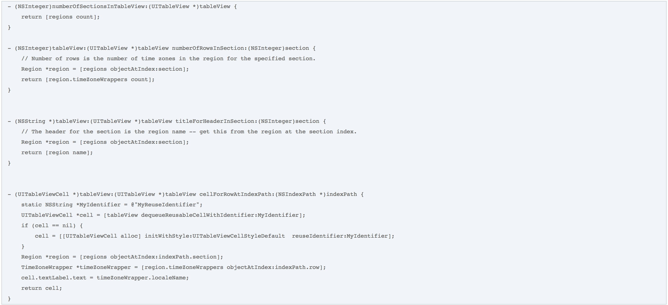

Slide 13

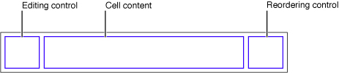
A Closer Look at Table View Cells
A table view uses cell objects to draw its visible rows and then caches those objects as long as the rows are visible. Cells inherit from the UITableViewCell class. The table view’s data source provides the cell objects to the table view by implementing the tableView:cellForRowAtIndexPath: method, a required method of the UITableViewDataSource protocol.
A cell object has various parts, which can change depending on the mode of the table view. Normally, most of a cell object is reserved for its content: text, image, or any other kind of distinctive identifier
When the table view goes into editing mode, the editing control for each cell object (if it’s configured to have such a control) appears on its left side

Slide 14
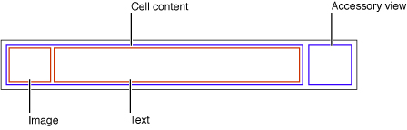
Using Cell Objects in Predefined Styles
The UITableViewCell class defines three properties for this cell content:
textLabel—A label for the title (a UILabel object)
detailTextLabel—A label for the subtitle if there is additional detail (a UILabel object)
imageView—An image view for an image (a UIImageView object)

Slide 15
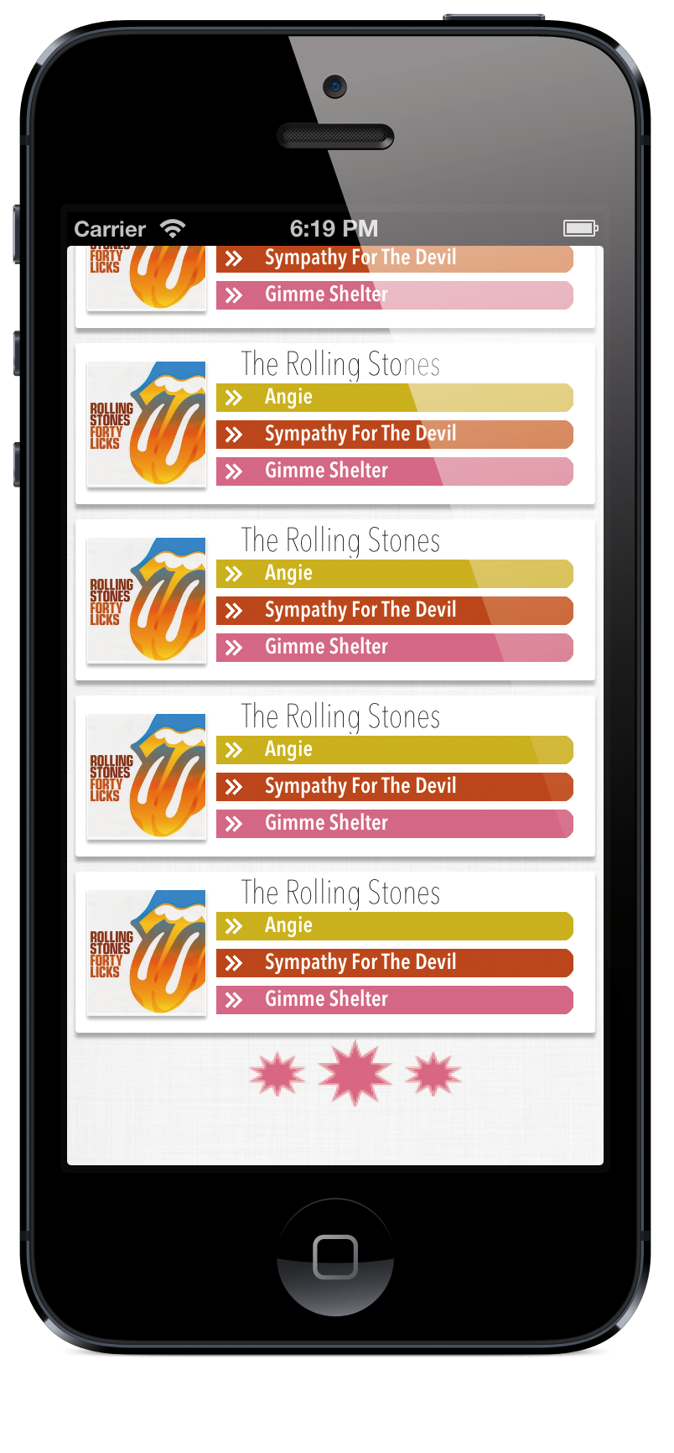
Customizing Cells
You have two alternatives:
Add subviews to a cell’s content view.
Create a custom subclass of UITableViewCell.
→ The following sections discuss both approaches.

Slide 16
Local DB
Core Data
SQLite

Slide 17
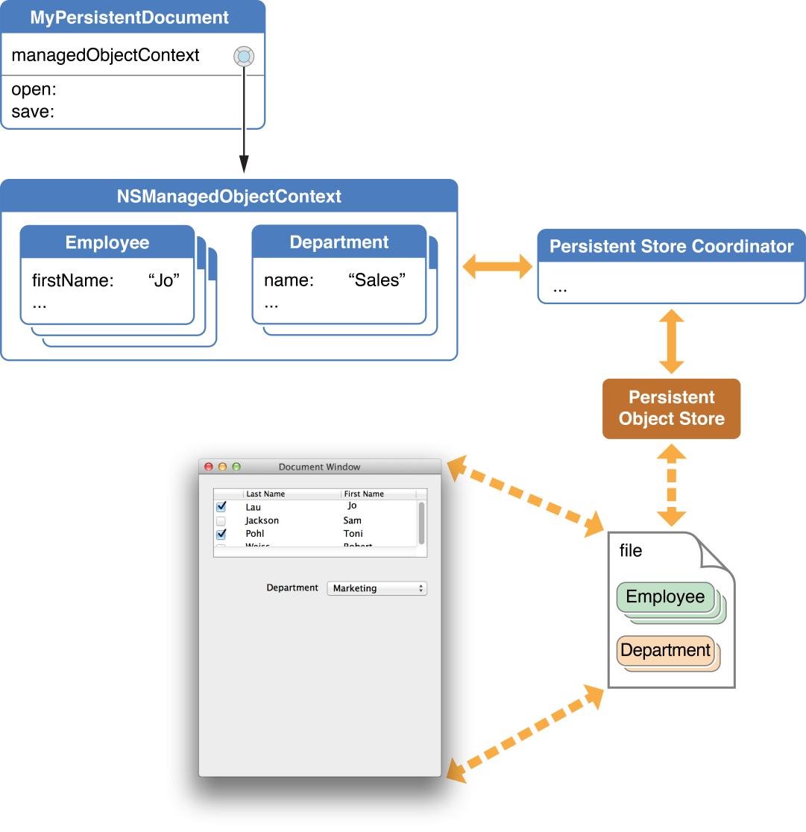
What Is Core Data?
Core Data is a framework that you use to manage the model layer objects in your application. It provides generalized and automated solutions to common tasks associated with object life cycle and object graph management, including persistence.

Slide 18
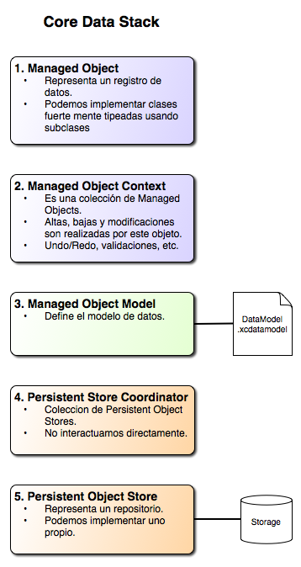
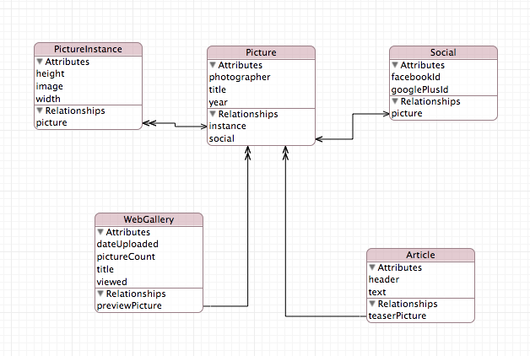

Slide 19
Troubleshooting Core Data
Object Life Cycle Problems
Problems with Fetching
Problems with Saving
Debugging Fetching
Managed Object Models
Bindings Integration

Slide 20

SQLite
SQLite is a simple and easy to use library that implements a simple database engine, treating a database as a simple flat file.
Link refer: http://sqlite.org
http://www.raywenderlich.com/913/sqlite-tutorial-for-ios-making-our-app

Slide 21
Troubleshooting sqlite
SQLite in iOS memory issues
SQLite DB, insert, update DB

Slide 22
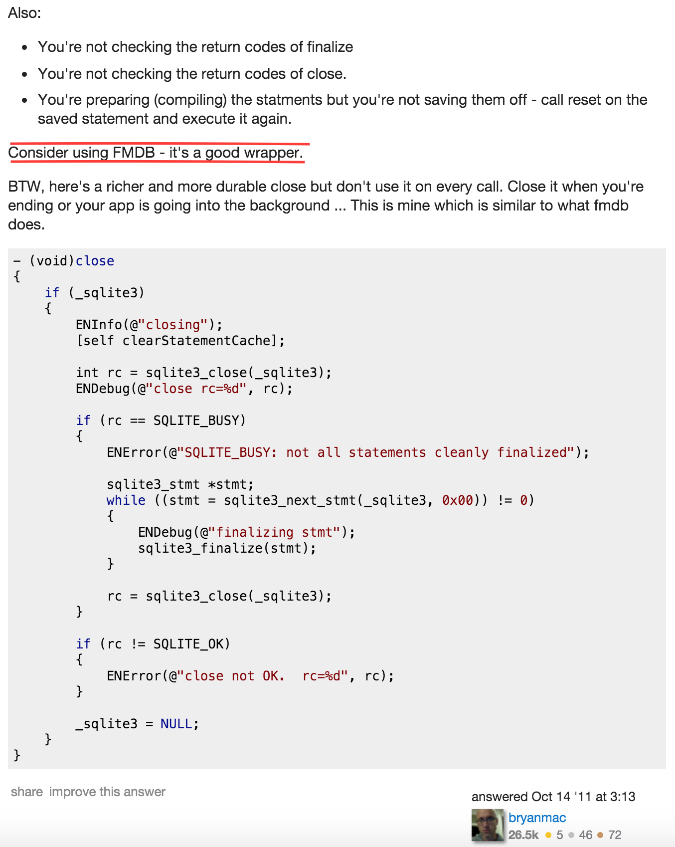
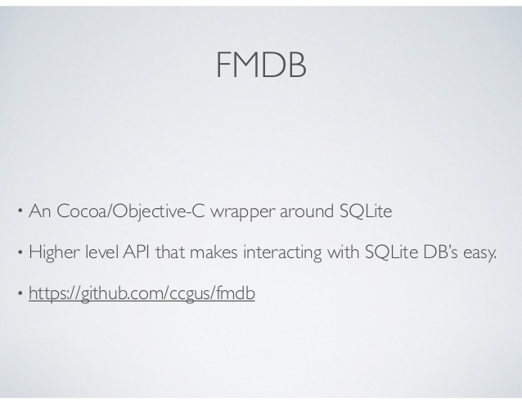
Remedy

Slide 23
Core data versus sqlite
Using this test application, let's look at a few key metrics. An iPhone 4s and 5s were tested, both running iOS version 7.1.1. The type of iPhone used, 4s or 5s, for a result is show within parentheses. For exampe (4s) denotes test results for an iPhone 4s, (5s) is for an iPhone 5s.
Memory Usage
Storage Size
Speed

Slide 24
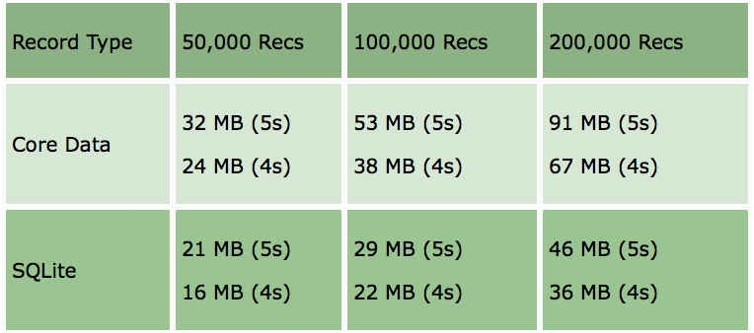
Memory Usage
Core Data uses more memory, from 40% to 100% more than SQLite. This makes sense considering how Core Data is designed (specifically, how the NSManagedObjectContext tracks all of the objects), where each object has a memory footprint of some size depending on whether the object's contents have been faulted in (realized in memory versus being a fault).

Slide 25
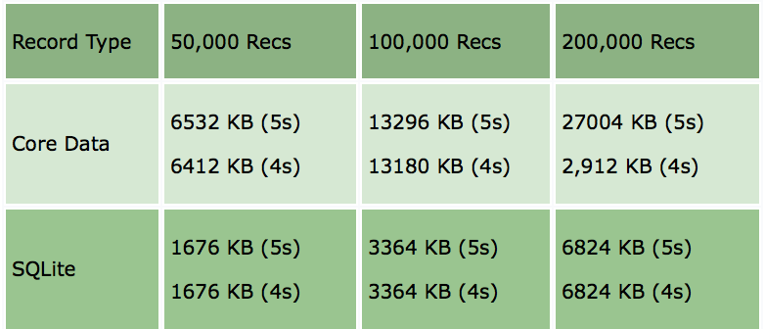
Storage Size
Core Data uses more storage space — a lot more storage space — approximately 4x more than SQLite

Slide 26
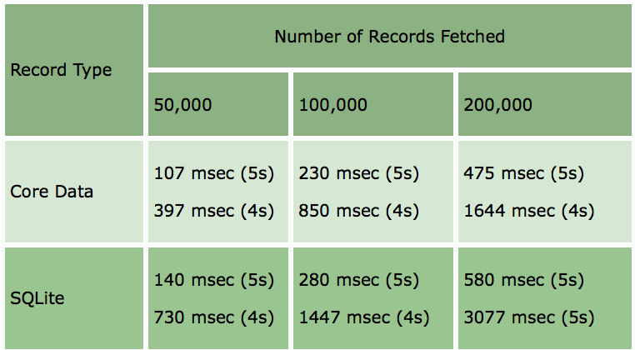
Speed
Both Core Data and SQLite are fast when fetching records. For the iPhone 5s, the differences are slight. However, for the 4s, Core Data is nearly 2x as fast. Table shows just one operation, fetching all of records.

Slide 27
Conclusion of Local DB
SQLite:
SQLite is, as advertised, lightweight.
SQLite uses less memory and storage space.
SQLite can be tedious and error-prone to code.
SQLite is supported on Android and Microsoft Windows Phone.
Core Data:
Longer learning curve: it takes some study to understand.
Objects are easier to work with.
Underlying storage details are handled atomically (support for iCloud).
Undo and Redo features.

